Slide 1
Uru neitak chawng iti a maw reirong
10
Robert Borden ta amanroptak mejek khinei 1935
• Chawngrophongna khan mejek na rikip a rotok na ath inih
Mejek mathar na a put loi inih
(Fairfield, NJ: The Economics Press, 1935)
Dr Rick Griffith, Singapore Bible College
www.biblestudydownloads.org

Slide 2
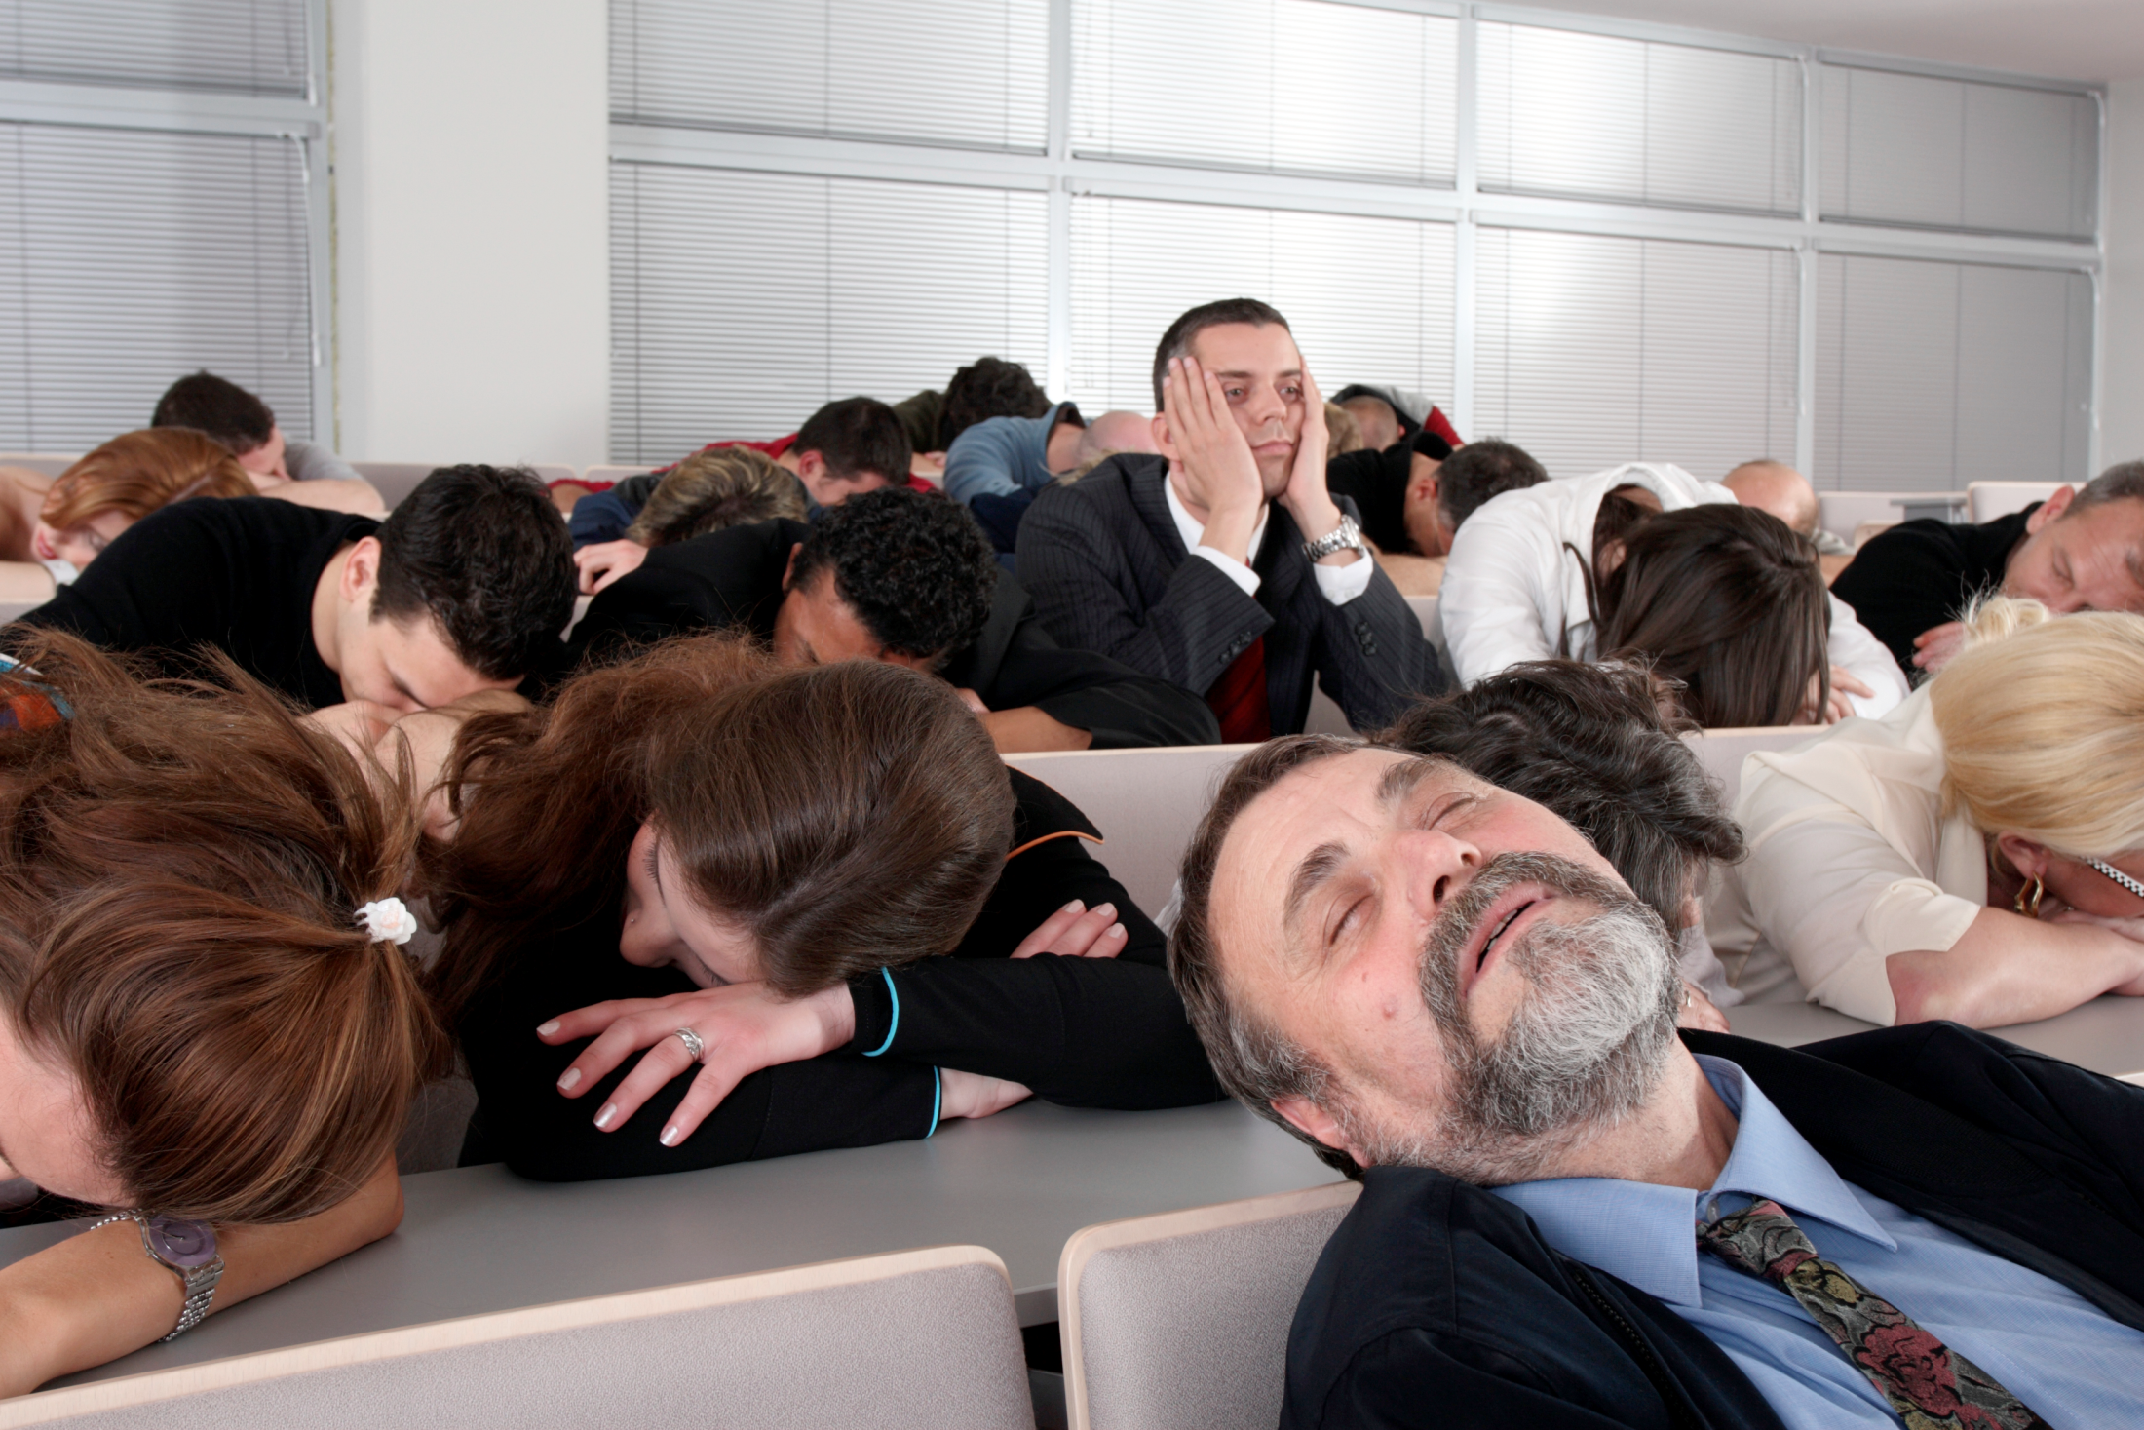
Chawngreihai nirangai jot boi tam pui awm…

Slide 3

Itidan-a Chawng nereile mina irangai jot rang a monih?

Slide 4
Lungdin Mili:
Makhala chawnglela…
25
Adik
Ohoina
Aretheng
Arolotna

Slide 5
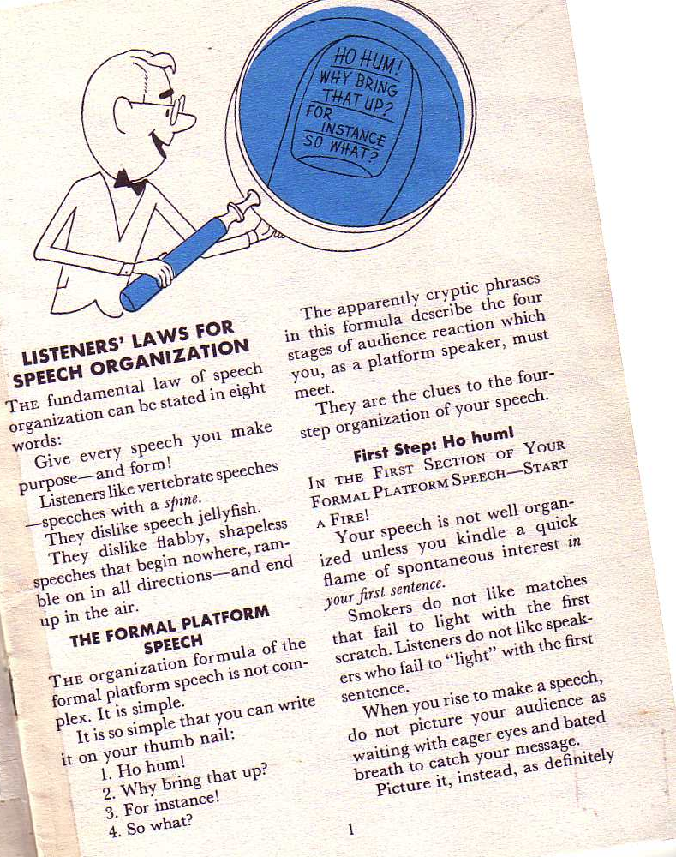
Borden Kungthoina
10-11
Chawngrei nathei kungnet met dan chawngrama eret ah reeinah: Nang Chawngreina kholoka kungchang
-khan arama mosok hetroh!
Richard Borden Ta, Uru neitak chawng iti a maw reirong, a put loi inih 1
Notes:
Same slide for presentation 01.30 and 03.05 so translators may copy from one to the other

Slide 6
Organization of a
Formal Platform Speech
11a
 | Anarangaihai Awmchan | Achawnghai a ijet ranga | Homi Parallel
1 | Ho hum!* | Start a fire | Capture attention or interest
2 | Why bring that up? | Build a bridge | Raise need
3 | For instance! | Get down to cases | Illustrations
4 | So what? | Ask for action | Application
Richard Borden Ta, Uru neitak chawng iti a maw reirong, a put loi inih 1
Notes:
*“Ho Hum” itihi, Chawnglelah, arei hai na, nijet rang atu; Nang chawng rangai haikar a, mitetan boi hai kha amothoi na inih.

Slide 7
Borden's Steps:
Chawngrophong amasangna…
11a
Adik:
Chawng-nei
Dan
Ohoina:
Ho hum!*
Chawngkhat a!
Aretheng:
Chawngrama Dan
Arolotna:
Eloi a makha reirang?
Kha shule emo?
Richard Borden Ta, Uru Neitak Chawng Iti a Maw Ieirong, a put loi inih 1
Notes:
“Ho Hum” itihi, Chawnglelah, arei hai na, nijet rang atu; Nang chawng rangai haikar a, mitetan boi hai kha amothoi na inih.

Slide 8

Imo nik irei rang?
(Chawngjawm)

Slide 9
Aranagai hai dan Chawg-nei
11a
Arangai hai na “chawngkhat a” iti rishim-rasham haihi jet jot u…
…
Rishim a
Miring iriming ase hai ta
Rishimlui hai amiringjin ngam
Amethaning rashaknachawng
Alumet rashakna aralam mashak ngam
Rilim-rasham le orojo mashak na
Richard Borden Ta, Uru Neitak Chawng Iti a Maw Ieirong, 10-14

Slide 10
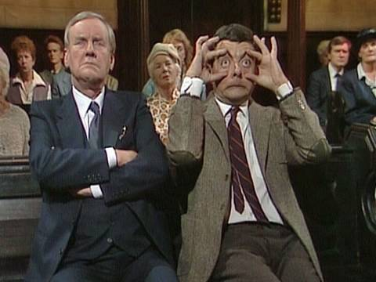
Eti a maw reining?
(Omoshokna)

Slide 11
Arangai hai dan Chawngrama
11a
Nik chawng hai kha hitihin nirosoh…
Konchawk ninorosoh (nemnaboi chawng rotokna noroh)
Chanwgdan mikip bir roh (Toitek a akipbir a reirioh)
Reshena chawng a reiroh
Ridingpip rosoh
Ame madang het rosoh
Retheng hei rosoh
Richard Borden Ta, Uru Neitak Chawng iti a Maw Reirong, 15-20

Slide 12
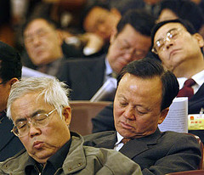
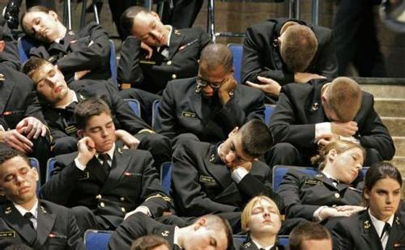
Sleepers

Slide 13
Black

Slide 14


Chawngrophongna (Retheina) hin awm BibleStudyDownloads.org
Mahi rachakna hi arem ah mukthei inih!
Notes:
Preaching (pr)
Homiletics

